Slide 1

ESO205P : Nature and Properties of the Materials
Module 6
Part A: Magnetic Hysteresis of a Material (Nickel)
Part B: Electrical Characterization of Semiconductors
Presented By
Rakesh Potnuru
Department of Materials Science and Engineering
Indian Institute of Technology Kanpur

Slide 2
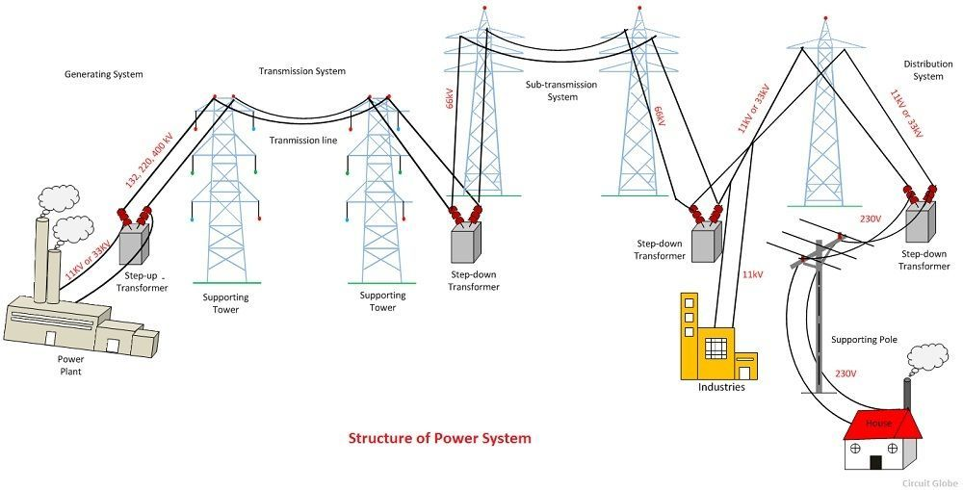
Part A: Magnetic Hysteresis of a Material (Nickel)
Transformers
Why started with a transformer?
Transformers do have Hysteresis losses.
Since they are many number of transformers from generating end to consumer end these losses play a crucial role.

Slide 3
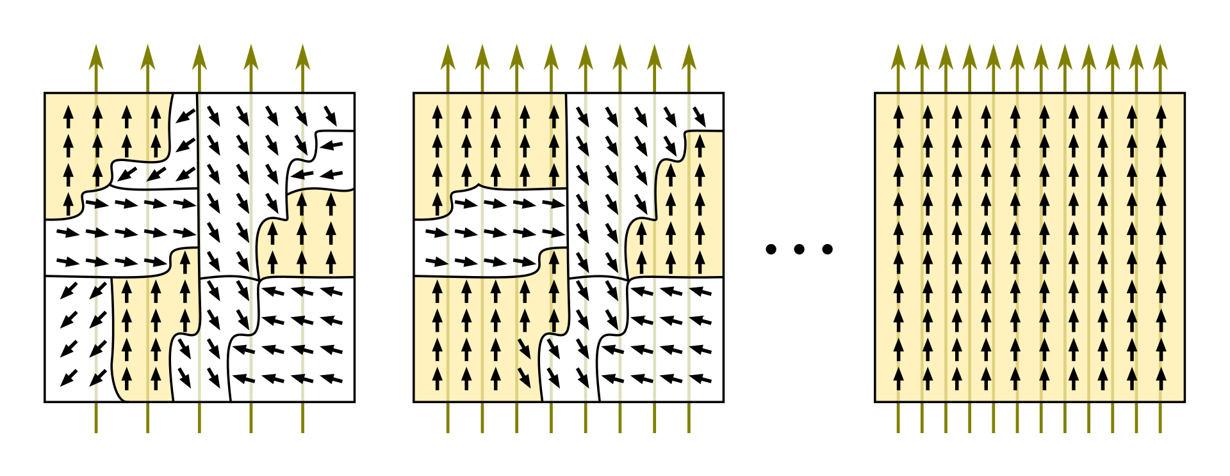
Part A: Magnetic Hysteresis of a Material (Nickel)
Domain Theory
A domain is a small region in a magnetic material, within which the local magnetization is saturated, i.e. spins on all the atoms are parallel.
In below figure: Number of lines indicates the strength of magnetic field.
Source: https://en.wikipedia.org/wiki/Magnetic_domain

Slide 4
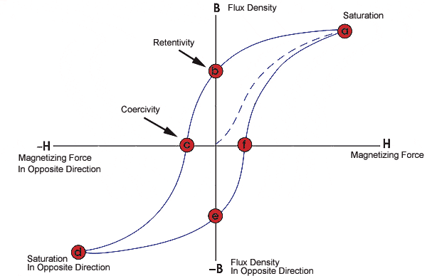
Part A: Magnetic Hysteresis of a Material (Nickel)
Parameters related to Hysteresis
Saturation(B_{s})
Coercivity (H_{c})
Retentivity (B_{r})
Permeability (𝜇) = B/H
Magnetostriction

Slide 5
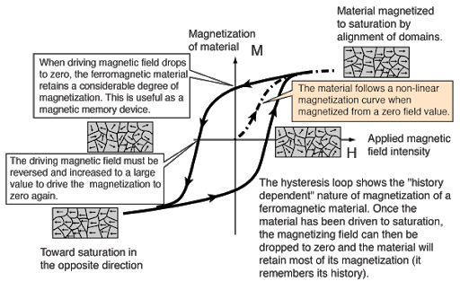
Part A: Magnetic Hysteresis of a Material (Nickel)
Energy Loss: Area of the hysteresis loop

Slide 6
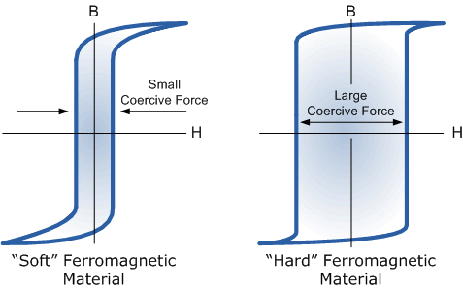
Part A: Magnetic Hysteresis of a Material (Nickel)
Hard Ferromagnetic Material
Soft Ferromagnetic Material
Q) Which one has higher energy losses?

Slide 7
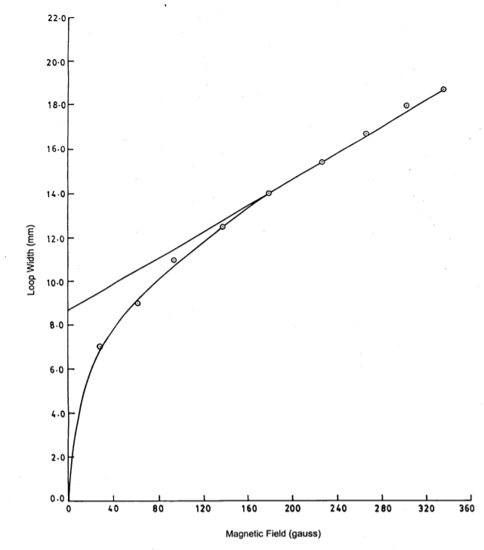
Part A: Magnetic Hysteresis of a Material (Nickel)
Math
Coercivity
Draw a asymptote to the curve
Take Hc as half the value of intercept(at zero field) to the asymptote

Slide 8
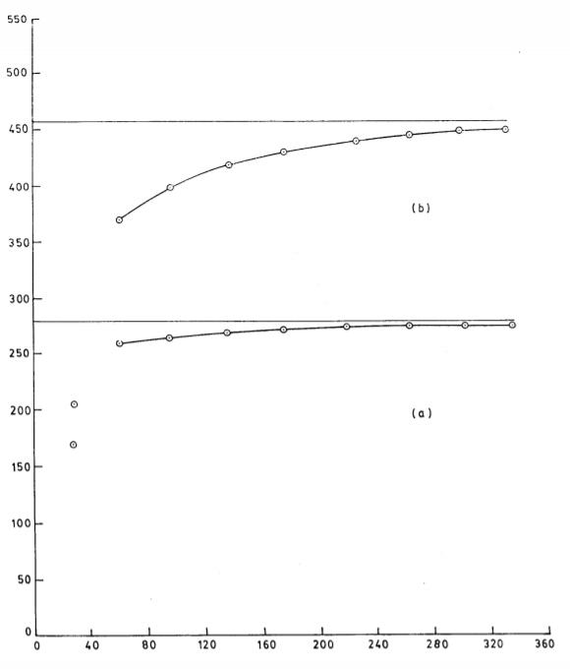
Part A: Magnetic Hysteresis of a Material (Nickel)
Math
(b)Tip to tip height
Retentivity: asymptotic value of the y-axis intercept
Saturation: half the asymptotic value of the tip- tip height
(a)Y-Intercept
Magnetic field(G)

Slide 9
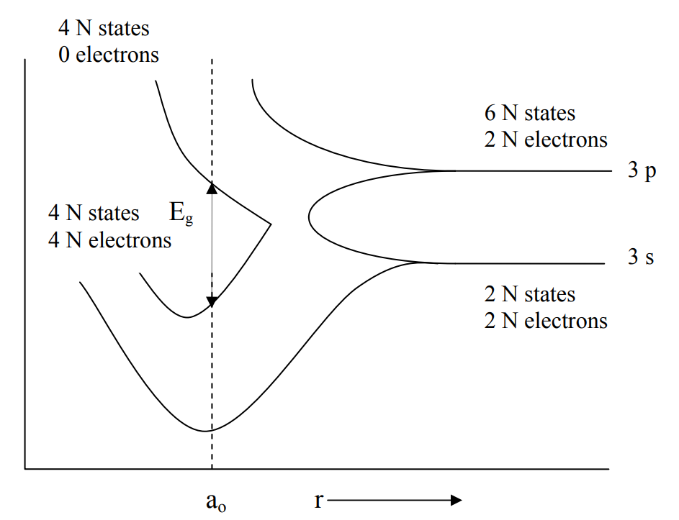
Part B: Electrical Characterization of Semiconductors
Bands and Energy Levels
The solid has N atoms, each atomic level must split into N sub-levels
The energy gap between the allowed energy bands is the forbidden energy gap or band gap E_{g}.
The highest completely filled [i.e. occupied with electrons] energy band at 0K is called valence band.
The next higher band is called the conduction band

Slide 10
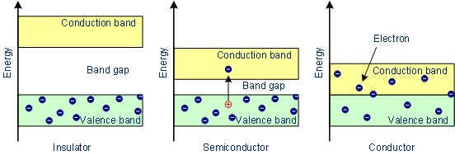
Part B: Electrical Characterization of Semiconductors
Band gap of Metals, Semiconductors, Insulators
E_{g} ∼5ev
E_{g} ∼2ev
E_{g} =0ev
Aim: To find the band gap of a semiconductor, resistivity and mobility of electrons.

Slide 11
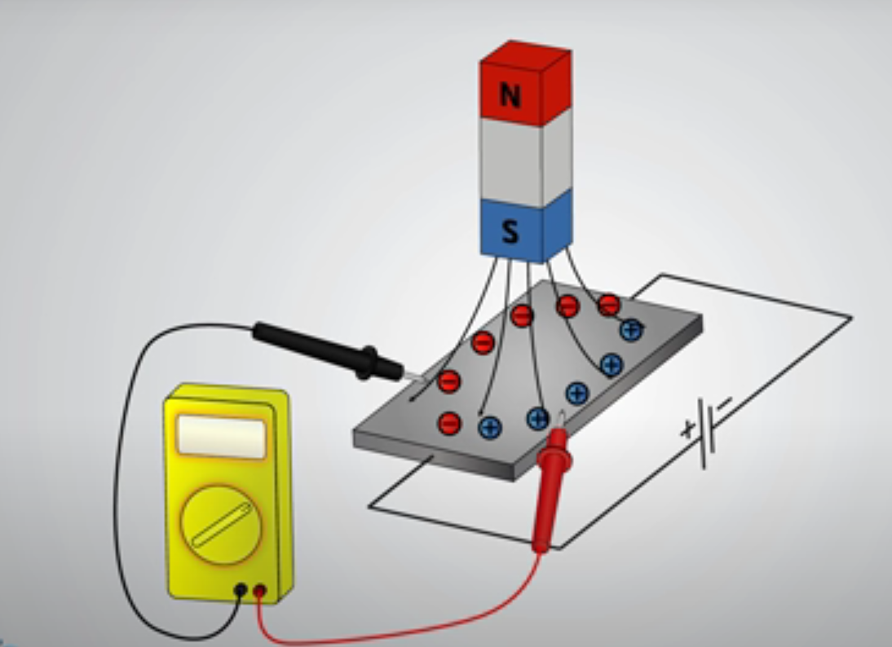
Part B: Electrical Characterization of Semiconductors
Hall Effect
The Hall effect is the production of a voltage difference across an electrical conductor that is transverse to an electric current in the conductor and to an applied magnetic field perpendicular to the current.
For better Understanding: https://www.youtube.com/watch?v=wpAA3qeOYiI&ab_channel=HowToMechatronics

Slide 12
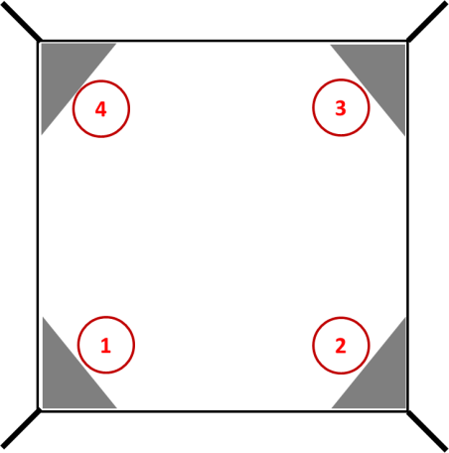




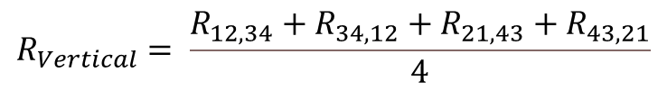


Part B: Electrical Characterization of Semiconductors
$$−$$
$$+$$
Math
V
Van der pauw method
$$R_{12, 34}= \frac{V_{34}}{I_{12}}$$
$R_{ 34, 12}$, $R_{21, 43}$, $R_{43,21}$
$$R_{Vertical}= \frac{R_{12, 34}+R_{34, 12}+R_{21, 43}+R_{43,21}}{4}$$
A
$$R_{Horizontal}= \frac{R_{23, 41}+R_{41, 23}+R_{32, 14}+R_{14, 32}}{4}$$
$$t=thickness$$

Slide 13
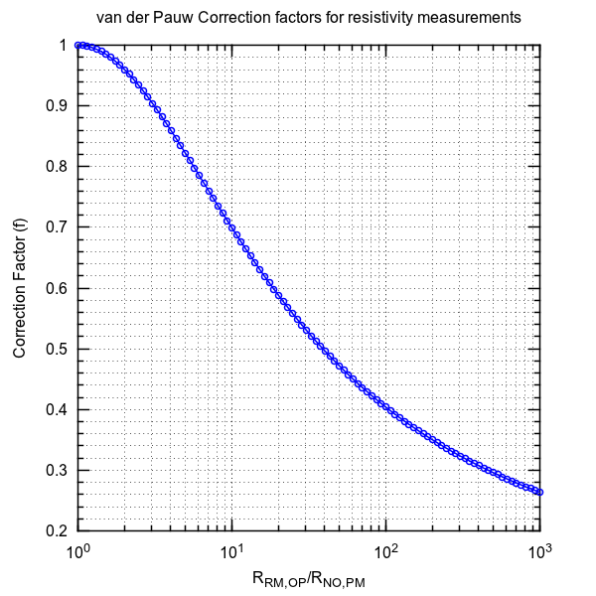


Part B: Electrical Characterization of Semiconductors
Math
$$\frac{R_{Vertical}}{R_{Horizontal}} or \frac{R_{Horizontal}}{R_{Vertical}} ≥1$$
$$ρ= \frac{π}{\ln{(2)}} t\left(\frac{R_{Vertical}+R_{Horizontal}}{2}\right)f$$

Slide 14




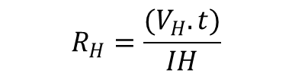






Part B: Electrical Characterization of Semiconductors
Math
$$Parameters we get Voltmeter reading \left(V\right), current applied \left(I\right), magnetic field\left(H\right) and thickness(t)$$
$$ρ=\frac{1}{σ}$$
$ρ=resistivity$ , $σ=conductivity$
$$R_{H}=\frac{(V_{H}.t)}{IH}$$
$$R_{H}=Hall co−efficient$$
$$μ=mobility$$
$μ=R_{H} .σ$
$$Supporting equations$$
$R_{H}=\frac{(V_{H}.Z)}{IH}$
$I=J.y.Z$
$v×H=E_{H}$
$R_{H}=\frac{E_{H}}{IH}=\frac{vH}{nqvH}=\frac{1}{nq}$
$σ=n q μ$
$μ=R_{H}σ$

Slide 15

Part B: Electrical Characterization of Semiconductors
Math
$$Parameters we get Voltmeter reading \left(V\right), current applied \left(I\right), magnetic field\left(H\right) and thickness(t)$$
$ρ=4.532 t \frac{V}{J}$ ; constant 4.532 depends upon various factors such as sample thickness, sample edges etc.
$ρ=c exp \left(\frac{E_{g}}{kT}\right)$ ⇒$\ln{\frac{ρ}{c}}=\frac{E_{g}}{kT}$
$$using different data points by varying the temperature we find Eg$$

Slide 16
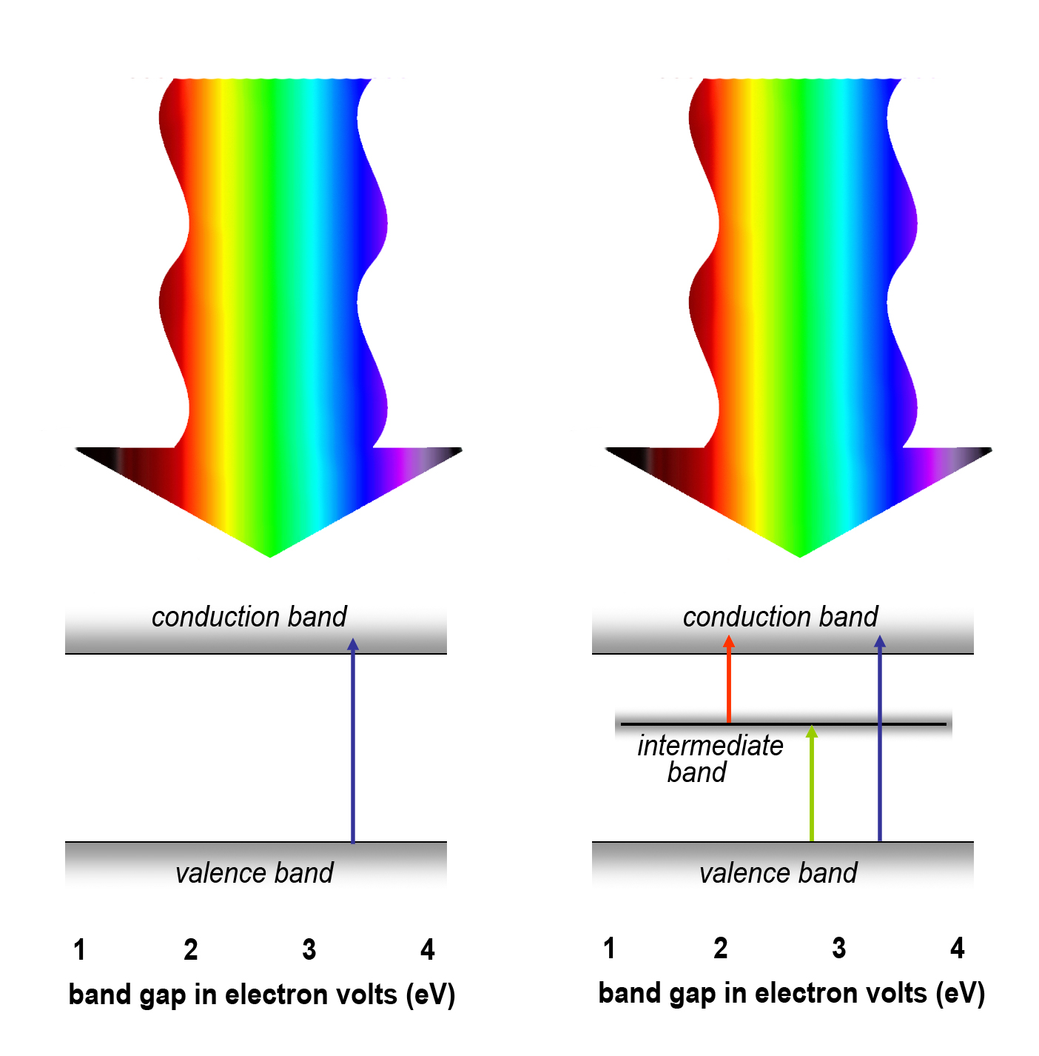
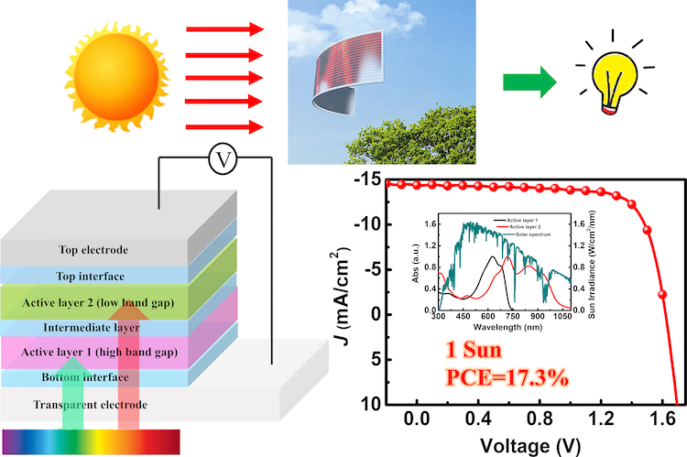
Part B: Electrical Characterization of Semiconductors
Solar cells
Solar energy of visible region (VIBGYOR) will excite the electrons from valence band to conduction band if incoming solar energy is greater than the band gap.
Tandem Solar cells are used to capture both lower energy and higher energy to get optimized output of current and voltage.

Slide 17
Thank You

